Slide 1
Relationell auch ohne SQL Relationale Datenbanken mit ScalaQuery nutzen
Stefan Zeiger
Commerzbank AG

Slide 2
Relationale Datenbanken
Größere Anwendungen brauchen oft Datenbanken
Relationales Modell verhindert Silobildung

Slide 3
Wozu? Wir haben doch JDBC
Notes:
----------------------------------------

Slide 4
Wozu? Wir haben doch JDBC
def usersMatching(pattern: String)(conn: Connection) = {
val st = conn.prepareStatement("select id, name from users where name like ?")
try {
st.setString(1, pattern)
val rs = st.executeQuery()
try {
val b = new ListBuffer[(Int, String)]
while(rs.next)
b.append((rs.getInt(1), rs.getString(2)))
b.toList
} finally rs.close()
} finally st.close()
}
Class.forName("org.h2.Driver")
val conn = DriverManager.getConnection("jdbc:h2:test1")
try {
println(usersMatching("%zeiger%")(conn))
} finally conn.close()
Notes:
Beispiel
----------------------------------------
Parameter
----------------------------------------
Rückgabewerte
----------------------------------------
Exception-Handling
----------------------------------------
Mutable State

Slide 5
JDBC
Gute Grundlage für Frameworks
Zu niedrige Abstraktionsebene für Anwendungen

Slide 6
ScalaQuery: Simple Queries
val usersMatching = query[String, (Int, String)]
("select id, name from users where name like ?")
Database.forURL("jdbc:h2:test1", driver = "org.h2.Driver") withSession {
println(usersMatching("%zeiger%").list)
}

Slide 7
Wozu? Wir haben doch ORMs
Object/Relational Mapping Tools
Hibernate, Toplink, JPA
Lösen des Problems
95%
80%
50%
Notes:
----------------------------------------
ORM
----------------------------------------
80%

Slide 8
Relationales Modell
Relational Model:
Relation
Attribute
Tuple
Relation Value
Relation Variable
COF_NAME | SUP_ID | PRICE
Colombian | 101 | 7.99
French_Roast | 49 | 8.99
Espresso | 150 | 9.99
Colombian_Decaf | 101 | 8.99
French_Roast_Decaf | 49 | 9.99
TABLE COFFEES
Beispiele aus: http://download.oracle.com/javase/tutorial/jdbc/basics/index.html
Notes:
----------------------------------------
Relation
----------------------------------------
Attribut
----------------------------------------
Tupel
----------------------------------------
Relationswert
----------------------------------------
Relationsvariable

Slide 9
Impedance Mismatch: Konzepte
Object-Oriented:
Identity
State
Behaviour
Encapsulation
Relational:
Identity
State
Behaviour
Encapsulation
: Transactional
Notes:
----------------------------------------
Identität
----------------------------------------
Nein
----------------------------------------
Zustand
----------------------------------------
Transaktional
----------------------------------------
Verhalten
----------------------------------------
Nein
----------------------------------------
Kapselung
----------------------------------------
Nein

Slide 10
Impedance Mismatch: Retrieval Strategies
Colombian
French_Roast
Espresso
Colombian_Decaf
French_Roast_Decaf
Espresso
Price: 9.99
Supplier: The High Ground
select COF_NAME from COFFEES
select c.*, s.SUP_NAME from COFFEES c, SUPPLIERS s where c.COF_NAME = ? and c.SUP_ID = s.SUP_ID
Notes:
Web-Site: Übersichtsliste
----------------------------------------
Einzelansicht

Slide 11
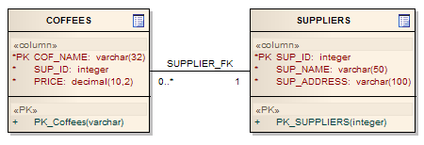

Impedance Mismatch: Retrieval Strategies
Notes:
Datenmodell
----------------------------------------
Objektmodell

Slide 12
Impedance Mismatch: Retrieval Strategies
def getAllCoffees(): Seq[Coffee] = …
def printLinks(s: Seq[Coffee]) {
for(c <- s) println(c.name )
}
def printDetails(c: Coffee) {
println(c.name)
println("Price: " + c.price)
println("Supplier: " + c.supplier.name)
}
+ " " + c.price
Notes:
Code
----------------------------------------
Was ist Seq? Vermutlich strict
Was ist Coffee? Vermutlich lazy
----------------------------------------
n+1 -> name strict machen
----------------------------------------
An anderer Stelle müsste price auch strict sein -> nicht allgemein festlegbar
----------------------------------------
Erst Coffee wegen price geladen -> Extra-Query für Supplier

Slide 13
O/R-Mapper
Falsche Abstraktionsebene
Nicht transparent

Slide 14
“Object/Relational Mapping is The Vietnam of Computer Science” (Ted Neward) http://blogs.tedneward.com/2006/06/26/The+Vietnam+Of+Computer+Science.aspx

Slide 15
A Better Match: Functional Programming
Relation
Attribute
Tuple
Relation Value
Relation Variable
case class Coffee(name: String,
supplierId: Int, price: Double)
val coffees
Coffee("French_Roast", 49, 8.99)
= Set(
Coffee("Colombian", 101, 7.99),
,
Coffee("Espresso", 150, 9.99)
)
- mutable state in the DB
Notes:
Funktionale Programmierung
----------------------------------------
case class
----------------------------------------
Konstruktor-Parameter
----------------------------------------
Tupel
----------------------------------------
Set
----------------------------------------
Variable
----------------------------------------
val

Slide 16

ScalaQuery
Session-Management
Typsichere Queries in Scala
+ Insert, Update, Delete, DDL
Direkte SQL-Statements
Gemeinsames API zur Ausführung beider Arten von Statements
org.scalaquery.session
org.scalaquery.ql
org.scalaquery.simple
org.scalaquery
Notes:
Überleitung
----------------------------------------
Wichtige ScalaQuery-Features

Slide 17
Session Management: Database
JDBC kennt zwei Connection-Management-Modelle: DriverManager und DataSource
Wie mit DriverManager Connections zu einer URL öffnen: Database.forURL(…)
Ein DataSource-Objekt verwenden: Database.forDataSource(…)
Ein DataSource-Objekt über einen JNDI-Namen holen: Database.forName(…)

Slide 18
Session Management: Session
Alle Zugriffe auf die Datenbank erfolgen über ein Session-Objekt
Wrapper für java.sql.Connection
Oft als implizites Objekt verwendet: Database.threadLocalSession
Kein Caching von Connections und PreparedStatements

Slide 19
Session Management
s withTransaction {
}
import org.scalaquery.session._
import org.scalaquery.session.Database.threadLocalSession
val db = Database.forURL("jdbc:h2:mem:test1",
driver = "org.h2.Driver")
db withTransaction {
doSomethingWithSession
}
s: Session =>
(s)
import org.scalaquery.session._
val db = Database.forURL("jdbc:h2:mem:test1",
driver = "org.h2.Driver")
db withSession {
doSomethingWithSession
}
import org.scalaquery.session.Database.threadLocalSession
Notes:
Mit threadLocalSession
----------------------------------------
ohne
----------------------------------------
Transaktion
----------------------------------------
auch direkt auf DB

Slide 20
Typsichere Queries: Scala-Collections
case class Coffee(
name: String,
supID: Int,
price: Double
)
val coffees = List(
Coffee("Colombian", 101, 7.99),
Coffee("Colombian_Decaf", 101, 8.99),
Coffee("French_Roast_Decaf", 49, 9.99)
)
val l = for {
c <- coffees if c.supID == 101
} yield (c.name, c.price)
l.foreach { case (n, p) => println(n + ": " + p) }
Scala Collections
Notes:
Scala-Collections
---------------------------------------->>

Slide 21
Typsichere Queries: Query Language
val Coffees = new Table[(String, Int, Double)]("COFFEES") {
def name = column[String]("COF_NAME", O.PrimaryKey)
def supID = column[Int]("SUP_ID")
def price = column[Double]("PRICE")
def * = name ~ supID ~ price
}
Coffees.insertAll(
("Colombian", 101, 7.99),
("Colombian_Decaf", 101, 8.99),
("French_Roast_Decaf", 49, 9.99)
)
val q = for {
c <- Coffees if c.supID === 101
} yield c.name ~ c.price
q.foreach { case (n, p) => println(n + ": " + p) }
ScalaQuery
Notes:
In ScalaQuery
----------------------------------------
Table-Objekt beschreibt Tabelle
----------------------------------------
Daten einfügen
----------------------------------------
Tupel-Typ
----------------------------------------
Query statt neuer Liste
----------------------------------------
=== statt ==
----------------------------------------
Projection-Operator ~ statt Tupel-Konstruktur
----------------------------------------
foreach führt Query aus

Slide 22
Tabellendefinitionen
val Suppliers = new Table[(Int, String, String,
String, String, String)]("SUPPLIERS") {
def id = column[Int ]("SUP_ID", O.PrimaryKey)
def name = column[String]("SUP_NAME")
def street = column[String]("STREET")
def city = column[String]("CITY")
def state = column[String]("STATE")
def zip = column[String]("ZIP")
def * = id ~ name ~ street ~ city ~ state ~ zip
def nameConstraint = index("SUP_NAME_IDX", name, true)
}
Notes:
Suppliers-Tabelle für die Kaffee-Lieferanten
----------------------------------------
Table-Konstruktor mit Tabellentyp + Name
----------------------------------------
Spalten
----------------------------------------
als def
----------------------------------------
Spalten-Parameter (für DDL)
----------------------------------------
*-Projektion
----------------------------------------
Index mit Unique-Constraint
---------------------------------------->>

Slide 23
Tabellendefinitionen
val Coffees = new Table[(String, Int, Double,
Int, Int)]("COFFEES") {
def name = column[String]("COF_NAME")
def supID = column[Int ]("SUP_ID")
def price = column[Double]("PRICE")
def sales = column[Int ]("SALES")
def total = column[Int ]("TOTAL")
def * = name ~ supID ~ price ~ sales ~ total
def supplier = foreignKey("SUP_FK", supID, Suppliers)(_.id)
def pk = primaryKey("COF_NAME_PK", name)
}
Notes:
Coffees-Tabelle
----------------------------------------
Foreign Key
----------------------------------------
expliziter Primary Key: Name, mehrere Spalten

Slide 24
Tabellen Erzeugen
val db = Database.forURL("jdbc:h2:mem:test1",
driver = "org.h2.Driver")
val Suppliers = …
val Coffees = …
db withSession {
(Suppliers.ddl ++ Coffees.ddl).create
}

Slide 25
Query Language Imports
import org.scalaquery.ql._
import org.scalaquery.ql.TypeMapper._
import org.scalaquery.ql.extended.H2Driver.Implicit._
import org.scalaquery.ql.extended.{ExtendedTable => Table}
basic.BasicDriver
extended.AccessDriver
extended.DerbyDriver
extended.H2Driver
extended.HsqldbDriver
extended.MySQLDriver
extended.PostgresDriver
extended.SQLiteDriver
extended.SQLServerDriver
def column[C : TypeMapper](n: String,
options: ColumnOption[C, ProfileType]*) = …
Notes:
Query Language
----------------------------------------
TypeMapper: schon benutzt bei column
----------------------------------------
Treiber + passende Table
----------------------------------------
Unterstützte Datenbanken

Slide 26
Ein DAO-Pattern
class DAO(driver: ExtendedProfile, db: Database) {
import driver.Implicit._
val Props = new Table[(String, String)]("properties") {
def key = column[String]("key", O.PrimaryKey)
def value = column[String]("value")
def * = key ~ value
}
def insert(k: String, v: String) = db withSession
Props.insert(k, v)
def get(k: String) = db withSession
( for(p <- Props if p.key === k)
yield p.value ).firstOption
}
Notes:
Treiber übergeben
alle Features im Profil definiert
----------------------------------------
Session-Handling hier im DAO
alternativ: auslagern

Slide 27
Inner Joins & Abstraktionen
for {
c <- Coffees if c.price < 9.0
s <- Suppliers if s.id === c.supID
} yield c.name ~ s.name
for {
c <- coffees if c.price < 9.0
s <- suppliers if s.id == c.supID
} yield (c.name, s.name)
Scala Collections
ScalaQuery
for {
c <- Coffees if c.price < 9.0
s <- c.supplier
} yield c.name ~ s.name
for {
c <- Coffees.cheaperThan(9.0)
s <- c.supplier
} yield c.name ~ s.name
val Coffees = new Table … {
def supplier = foreignKey("SUP_FK", supID, Suppliers)(_.id)
}
val Coffees = new Table … {
def supplier = Suppliers.where(_.id === supID)
}
val Coffees = new Table … {
def supplier = Suppliers.where(_.id === supID)
def cheaperThan(d: Double) = this.where(_.price < d)
}
Suppliers.where(_.id === supID)
Notes:
Verschachtelte Schleifen mit Collections
----------------------------------------
Impliziter Inner Join in ScalaQuery
----------------------------------------
Bekannt aus Foreign Key
----------------------------------------
Foreign Key direkt navigierbar
----------------------------------------
geht auch ohne FK
----------------------------------------
weitere Abstraktionsmöglichkeit

Slide 28
Datentypen
Basistypen
Byte, Int, Long
String
Boolean
Date, Time, Timestamp
Float, Double
Blob, Clob, Array[Byte]
Option[T] für alle Basistypen T
Datenbank-NULL wird auf Default-Wert gemappt
0
""
false
1970-1-1 00:00:00
0.0
null, null, []
None
Notes:
Basistypen, Option, Default
----------------------------------------
Default-Werte für alle Typen

Slide 29
NULL
Three-Valued Logic (3VL) in SQL
a ⊕ b → NULL
wenn a = NULL oder b = NULL
Gilt auch für „=“
a = NULL → NULL
NULL = a → NULL
a IS NULL → TRUE oder FALSE

Slide 30
NULL
In ScalaQuery über OptionMapper abgebildet
Für Basistypen A, B, C:
Column[ A ] ⊕ Column[ B ] → Column[ C ] Column[Option[A]] ⊕ Column[ B ] → Column[Option[C]]
Column[ A ] ⊕ Column[Option[B]] → Column[Option[C]]
Column[Option[A]] ⊕ Column[Option[B]] → Column[Option[C]]

Slide 31
Eigene Datentypen Verwenden
object Values extends Enumeration {
val a, b, c = Value
}
implicit val valuesTypeMapper =
MappedTypeMapper.base[Values.Value, Int](_.id, Values(_))
val MyTable = new Table[Values.Value]("MYTABLE") {
def a = column[Values.Value]("A")
def * = a
}
MyTable.ddl.create
MyTable.insertAll(Values.a, Values.c)
val q = MyTable.map(t => t.a ~ t.a.asColumnOf[Int])
q.foreach(println)
(a,0)
(c,2)
Notes:
Enumeration
----------------------------------------
MappedTypeMapper.base reicht meist für Anwendungsentwicklung
TypeMapper auch flexibler direkt zu implementieren
----------------------------------------
Einfügen
----------------------------------------
Auslesen
asColumnOf

Slide 32
Aggregieren und Sortieren
val q = for {
c <- Coffees
s <- c.supplier
_ <- Query groupBy s.id
_ <- Query orderBy c.name.count
} yield s.id ~ s.name.min.get ~ c.name.count
Aggregierungsmethoden: .min, .max, .avg, .sum, .count
Notes:
groupBy, orderBy
----------------------------------------
Nur Spalten aus groupBy dürfen direkt in orderBy oder yield verwendet werden
----------------------------------------
Andere Spalten aggregiert
----------------------------------------
Aggregierungsmethoden

Slide 33
Operatoren Für Columns
Allgemein: .in(Query), .notIn(Query), .count, .countDistinct, .isNull, .isNotNull, .asColumnOf, .asColumnOfType
Vergleiche: === (.is), =!= (.isNot), <, <=, >, >=, .inSet, .inSetBind, .between, .ifNull
Numerisch: +, -, *, /, %, .abs, .ceil, .floor, .sign, .toDegrees, .toRadians
Boolean: &&, ||, .unary_!
String: .length, .like, ++, .startsWith, .endsWith, .toUpperCase, .toLowerCase, .ltrim, .rtrim, .trim

Slide 34
Invokers
Alle Datenbankzugriffe erfolgen über Invoker
Eine implizite Konvertierung von Query nach Invoker erlaubt das direkte Ausführen von Queries

Slide 35
Invoker-Methoden: Strict
.to[C]() – erzeugt eine Collection C aller Ergebnisse
.list – Shortcut für .to[List]()
.toMap – erzeugt eine Map[K,V] für einen Query[(K,V)]
.first, .firstOption, .firstFlatten – geben das erste Ergebnis zurück
z.B. myQuery.to[List]()
myQuery.to[Array]()

Slide 36
Invoker-Methoden: Lazy / Incremental
.elements – erzeugt CloseableIterator, der alle Ergebnisse bei Bedarf liest
.elementsTo – nur bis zur angegebenen Maximalanzahl
.foreach – führt die angegebene Funktion für jedes Ergebnis aus
Optional mit Maximalanzahl
.foldLeft – berechnet einen Wert aus allen Ergebnissen
.execute – führt das Statement aus
for(r <- myQuery) ...

Slide 37
Debugging
val q = for {
c <- Coffees if c.supID === 101
} yield c.name ~ c.price
q.dump("q: ")
println(q.selectStatement)
q: Query
select: Projection2
0: NamedColumn COF_NAME
table: <t1> AbstractTable.Alias
0: <t2> Table COFFEES
1: NamedColumn PRICE
table: <t1> ...
where: Is(NamedColumn SUP_ID,ConstColumn[Int] 101)
0: NamedColumn SUP_ID
table: <t1> ...
1: ConstColumn[Int] 101
SELECT "t1"."COF_NAME","t1"."PRICE"
FROM "COFFEES" "t1“
WHERE ("t1"."SUP_ID"=101)
Notes:
Einfaches Beispiel
----------------------------------------
Syntaxbaum
----------------------------------------
SQL-Statement

Slide 38
Explizite Inner Joins
name | supID
Colombian | 101
Espresso | 150
Colombian_Decaf | 42
Coffees
id | name
101 | Acme, Inc.
49 | Superior Coffee
150 | The High Ground
Suppliers
for (
Join(c, s) <- Coffees innerJoin Suppliers on (_.supID === _.id)
) yield c.name ~ s.name
(Colombian,Acme, Inc.)
(Espresso,The High Ground)
Notes:
braucht man eigentlich nicht -> implizit ist einfacher
---------------------------------------->>

Slide 39
Left Outer Joins
name | supID
Colombian | 101
Espresso | 150
Colombian_Decaf | 42
Coffees
id | name
101 | Acme, Inc.
49 | Superior Coffee
150 | The High Ground
Suppliers
for (
Join(c, s) <- Coffees leftJoin Suppliers on (_.supID === _.id)
) yield c.name ~ s.name
(Colombian,Acme, Inc.)
(Espresso,The High Ground)
(Colombian_Decaf,)
for (
Join(c, s) <- Coffees leftJoin Suppliers on (_.supID === _.id)
) yield c.name.? ~ s.name.?
(Some(Colombian),Some(Acme, Inc.))
(Some(Espresso),Some(The High Ground))
(Some(Colombian_Decaf),None)
Notes:
Left Outer Join:
Erzeugt eine Dummy-Zeile, wenn die rechte Seite leer ist
DB liefert NULL-Werte
Hier auf Default gemappt
----------------------------------------
Mit .? Zu Option gemacht -> NULL wird als None sichtbar
----------------------------------------
---------------------------------------->>

Slide 40
Right Outer Joins
name | supID
Colombian | 101
Espresso | 150
Colombian_Decaf | 42
Coffees
id | name
101 | Acme, Inc.
49 | Superior Coffee
150 | The High Ground
Suppliers
for (
Join(c, s) <- Coffees rightJoin Suppliers on (_.supID === _.id)
) yield c.name.? ~ s.name.?
(Some(Colombian),Some(Acme, Inc.))
(None,Some(Superior Coffee))
(Some(Espresso),Some(The High Ground))
Notes:
---------------------------------------->>

Slide 41
Full Outer Joins
name | supID
Colombian | 101
Espresso | 150
Colombian_Decaf | 42
Coffees
id | name
101 | Acme, Inc.
49 | Superior Coffee
150 | The High Ground
Suppliers
for (
Join(c, s) <- Coffees outerJoin Suppliers on (_.supID === _.id)
) yield c.name.? ~ s.name.?
(Some(Colombian),Some(Acme, Inc.))
(None,Some(Superior Coffee))
(Some(Espresso),Some(The High Ground))
(Some(Colombian_Decaf),None)

Slide 42
Case
for {
c <- Coffees
} yield (Case when c.price < 8.0 then "cheap"
when c.price < 9.0 then "medium"
otherwise "expensive") ~ c.name
If-then-else für Queries
Rückgabetyp wird automatisch zu Option, wenn otherwise fehlt
Notes:
Case
----------------------------------------
Rückgabetype

Slide 43
Sub-Queries
for {
c <- Coffees
s <- c.supplier
_ <- Query groupBy s.id orderBy s.id
} yield s.name.min.get ~ c.price.min.get
for {
c <- Coffees
s <- c.supplier
_ <- Query if c.price === lowestPriceForSupplier
_ <- Query orderBy s.id
} yield s.name ~ c.price
val lowestPriceForSupplier = (for {
c2 <- Coffees
s2 <- c2.supplier if s2.id === s.id
} yield c2.price.min).asColumn
Auch in yield verwendbar
Direkt (ohne .asColumn) mit .in und .notIn
.exists, .count
Notes:
Wie ohne groupBy?
Vereinfachung: Niedrigster Preis pro Anbieter ist eindeutig
----------------------------------------
wir brauchen lowestPriceForSupplier
----------------------------------------
als Query
Mit .asColumn als Sub-Query eingebettet
----------------------------------------
Correlated Sub-Query
----------------------------------------
auch in yield
----------------------------------------
direkt in .in und .notIn
----------------------------------------
.exists und .count

Slide 44
Unions
val l1 = coffees.filter(_.supID == 101)
val l2 = coffees.filter(_.supID == 150)
val l3 = l1 ++ l2
val q1 = Coffees.filter(_.supID === 101)
val q2 = Coffees.filter(_.supID === 150)
val q3 = q1 union q2
Scala Collections
ScalaQuery
All
Notes:
Collections
----------------------------------------
unionAll
----------------------------------------
union

Slide 45
Paginierung
val l = for {
c <- coffees if …
} yield …
val l2 = l.drop(20).take(10)
val q = for {
c <- Coffees if …
_ <- Query orderBy c.name
} yield …
val q2 = q.drop(20).take(10)
Scala Collections
ScalaQuery
Notes:
Collections: take und drop
----------------------------------------
ScalaQuery: genauso
----------------------------------------
DB-Ergebnisse sind normalerweise unsortiert!

Slide 46
Bind-Variablen
def coffeesForSupplier(supID: Int) = for {
c <- Coffees if c.supID === supID
} yield c.name
coffeesForSupplier(42).list
.bind
Query
select: NamedColumn COF_NAME
table: <t1> AbstractTable.Alias
0: <t2> Table COFFEES
where: Is(NamedColumn SUP_ID,ConstColumn[Int] 42)
0: NamedColumn SUP_ID
table: <t1> ...
1: ConstColumn[Int] 42
SELECT "t1"."COF_NAME" FROM "COFFEES" "t1"
WHERE ("t1"."SUP_ID"=42)
=?)
Bind
Bind
Notes:
Einfacher Query: Aber was passiert wann?
----------------------------------------
Syntaxbaum erzeugen
----------------------------------------
SQL erzeugen und ausführen
Konstante steht direkt im Code
Sicherheitsproblem
Statement-Cache und Query Plan
----------------------------------------
Bind-Variable vermeidet die Probleme
Weiterhin Performance-Problem im Scala-Code
---------------------------------------->>

Slide 47
Query-Templates
val coffeesForSupplier = for {
supID <- Parameters[Int]
c <- Coffees if c.supID === supID
} yield c.name
coffeesForSupplier(42).list
Query
select: NamedColumn COF_NAME
table: <t1> AbstractTable.Alias
0: <t2> Table COFFEES
where: Is(NamedColumn SUP_ID,ParameterColumn[Int])
0: NamedColumn SUP_ID
table: <t1> ...
1: ParameterColumn[Int]
SELECT "t1"."COF_NAME" FROM "COFFEES" "t1"
WHERE ("t1"."SUP_ID"=?)
Notes:
Query-Templates
----------------------------------------
Parameter-Objekt
Auch mehr Parameter: Generiert dann Tupel
----------------------------------------
als val deklariert: Nur einmal ausführen
----------------------------------------
erzeugt kompletten Syntaxbaum und SQL-Code
----------------------------------------
Parametrisierung ist jetzt billig

Slide 48
Mapped Entities
case class Coffee(name: String, supID: Int, price: Double)
Coffee
(String, Int, Double)
val Coffees = new Table[ ]("COFFEES") {
def name = column[String]("COF_NAME", O.PrimaryKey)
def supID = column[Int]("SUP_ID")
def price = column[Double]("PRICE")
def * = name ~ supID ~ price
}
Coffees.insertAll(
("Colombian", 101, 7.99),
("French_Roast", 49, 8.99)
)
val q = for(c <- Coffees if c.supID === 101) yield c
q.foreach(println)
<> (Coffee, Coffee.unapply _)
Coffee
Coffee
(Colombian,101,7.99)
Coffee
Notes:
einfaches Beispiel mit Tupel
----------------------------------------
passende Case Class
----------------------------------------
wollen wir verwenden
----------------------------------------
bidirektionales Mapping

Slide 49
Insert, Delete, Update
class Coffees(n: String)
extends Table[(String, Int, Double)](n) {
def name = column[String]("COF_NAME")
def supID = column[Int]("SUP_ID")
def price = column[Double]("PRICE")
def * = name ~ supID ~ price
}
val Coffees1 = new Coffees("COFFEES_1")
val Coffees2 = new Coffees("COFFEES_2")
(Coffees1.ddl ++ Coffees2.ddl).create
Coffees1.insertAll(
("Colombian", 101, 7.99),
("French_Roast", 49, 8.99),
("Espresso", 150, 9.99)
)
println(Coffees1.insertStatement)
INSERT INTO "COFFEES1" ("COF_NAME","SUP_ID","PRICE") VALUES (?,?,?)
Notes:
im Prinzip schon bekannt
zwei Tabellen aus einer Klasse -> nicht in SQL, aber kein Problem in Scala
einfügen in Coffees1
----------------------------------------
Statement ausgeben
---------------------------------------->>

Slide 50
Insert, Delete, Update
val q = Coffees1.where(_.supID === 101)
Coffees2.insert(q)
println(Coffees2.insertStatementFor(q))
q.delete
println(q.deleteStatement)
INSERT INTO "COFFEES2" ("COF_NAME","SUP_ID","PRICE")
SELECT "t1"."COF_NAME","t1"."SUP_ID","t1"."PRICE" FROM "COFFEES1" "t1"
WHERE ("t1"."SUP_ID"=101)
DELETE FROM "COFFEES1" WHERE ("COFFEES1"."SUP_ID"=101)
Notes:
Query auch für Insert
----------------------------------------
Statement ansehen
----------------------------------------
aus Original-Tabelle löschen
----------------------------------------
Statement ansehen
---------------------------------------->>

Slide 51
Insert, Delete, Update
val q2 = q.map(_.supID)
q2.update(49)
println(q2.updateStatement)
UPDATE "COFFEES1" SET "SUP_ID"=? WHERE ("COFFEES1"."SUP_ID"=101)
Notes:
Alternativ: Original updaten
----------------------------------------
Statement ausgeben

Slide 52
Static Queries
import org.scalaquery.simple._
import org.scalaquery.simple.StaticQuery._
def allCoffees = queryNA[String](
"select cof_name from coffees").list
def supplierNameForCoffee(name: String) =
query[String, String]("""
select s.sup_name from suppliers s, coffees c
where c.cof_name = ? and c.sup_id = s.sup_id
""").firstOption(name)
def coffeesInPriceRange(min: Double, max: Double) =
query[(Double, Double), (String, Int, Double)]("""
select cof_name, sup_id, price from coffees
where price >= ? and price <= ?
""").list(min, max)
Notes:
Direkt SQL schreiben, wenn man es braucht
----------------------------------------
NA = No Args; Rückgabetyp String
----------------------------------------
Query mit Parameter
----------------------------------------
Parametrisierter Invoker
----------------------------------------
Mehrere Parameter und Rückgabewerte als Tupel
---------------------------------------->>

Slide 53
Static Queries
import org.scalaquery.simple._
import org.scalaquery.simple.StaticQuery._
case class Coffee(
name: String, supID: Int, price: Double)
implicit val getCoffeeResult = GetResult(r => Coffee(r<<, r<<, r<<))
def coffeesInPriceRange(min: Double, max: Double) =
query[(Double, Double), (String, Int, Double)]("""
select cof_name, sup_id, price from coffees
where price >= ? and price <= ?
""").list(min, max)
[P : SetParameter,
R : GetResult]
Coffee
Notes:
SetParameter und GetResult: Implicits zur Konvertierung
Für Tupel und Basisdatentypen vorhanden
----------------------------------------
eigene Case Class
----------------------------------------
eigener Konverter

Slide 54
Weitere Features
Mutating Queries
JDBC-Metadaten
Iteratees
Sequences
Dynamic Queries
MutatingInvoker.mutate
org.scalaquery.meta
org.scalaquery.iter
org.scalaquery.simple

Slide 55
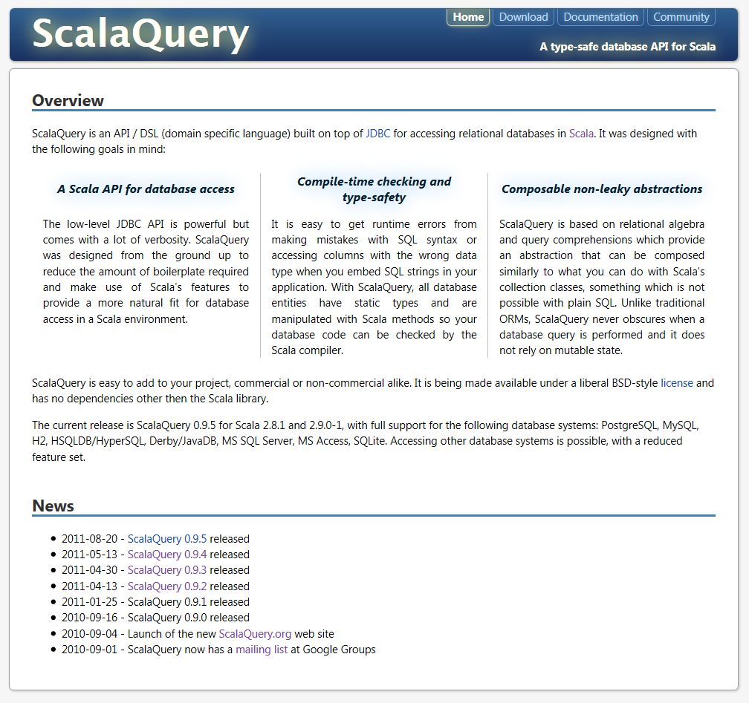
Getting Started
http://scalaquery.org
https://github.com/szeiger/scalaquery-examples
https://github.com/szeiger/scala-query/ tree/master/src/test/scala/org/scalaquery/test

Slide 56

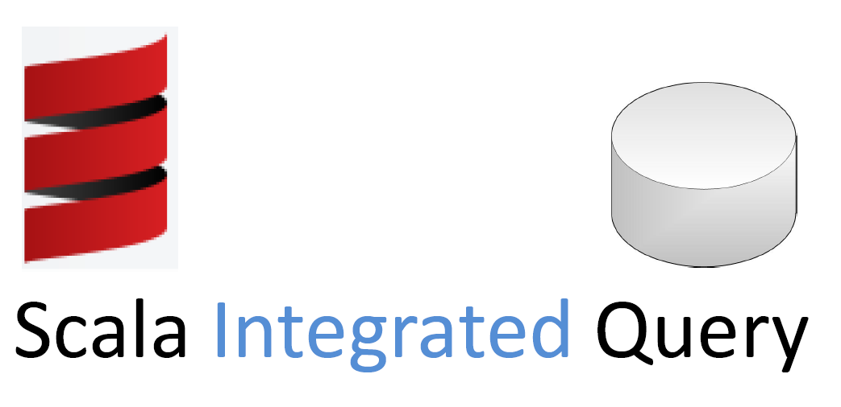
Ausblick
Slick – A common framework for connecting with databases and distributed collections
by Christopher Vogt
http://code.google.com/p/scala-integrated-query/
Notes:
Typesafe, Slick
----------------------------------------
SIQ + SQ
---------------------------------------->>

Slide 57
Ausblick
ScalaQuery 0.9
ScalaQuery 0.10
for {
c <- Coffees if c.price === 8.99 || c.price === 9.99
s <- c.supplier orderBy s.id
} yield s.id ~ s.name ~ c.name ~ c.price ~ …
for {
c <- Coffees if c.price === 8.99 || c.price === 9.99
s <- c.supplier orderBy s.id
} yield ((s.id, s.name), c)
for {
s <- Suppliers
val cs = Coffees.filter(c => c.supID === s.id &&
(c.price === 8.99 || c.price === 9.99))
} yield ((s.id, s.name), cs)
for {
s <- Suppliers
val cs = Coffees.filter(c => c.supID == s.id &&
(c.price == 8.99 || c.price == 9.99))
} yield ((s.id, s.name), cs)
Virtualized Scala
SIQ
Notes:
aktuell
----------------------------------------
SQ 0.10: Nested Tuples
----------------------------------------
SIQ: Nested Collections
----------------------------------------
Language Virtualization:
auch Operatoren wie == nutzbar
weitere Features wie Pattern-Matching und echtes if-else

Slide 58
Vielen Dank!
Stefan Zeiger
Commerzbank AG
http://szeiger.de
Twitter: @StefanZeiger

